Slide 1



CryptoCurrency
Does the Bitcoin leads everything?
Juwon Lee, Economics and Statistics, Yonsei University

Slide 2
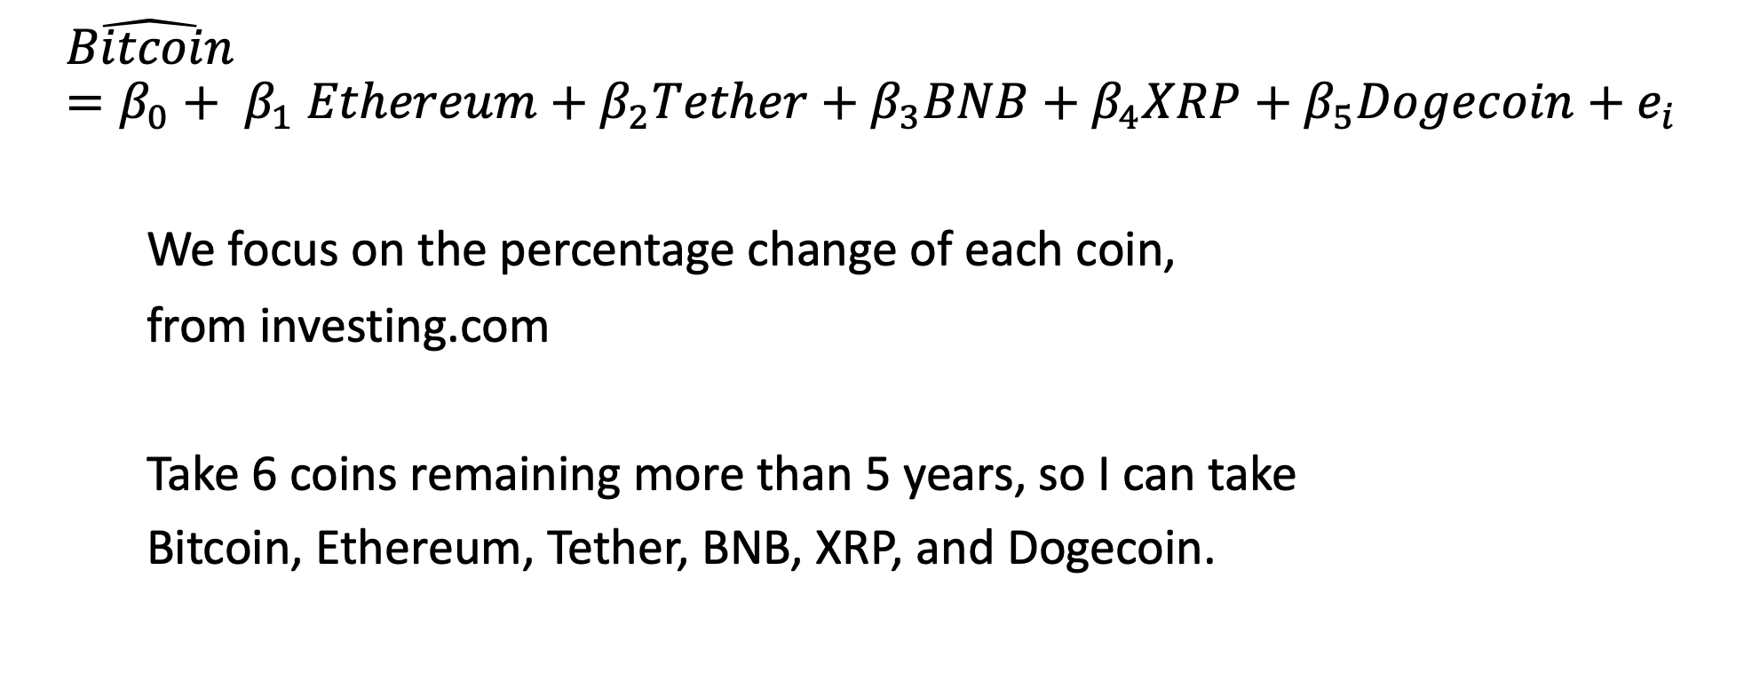
The model setting
$$\hat{Bitcoin}=β_{0}+ β_{1} Ethereum+β_{2}Tether+β_{3}BNB+β_{4}XRP+β_{5}Dogecoin+e_{i}$$
We focus on the percentage change of each coin,
from investing.com
Take 6 coins remaining more than 5 years, so I can take
Bitcoin, Ethereum, Tether, BNB, XRP, and Dogecoin.

